Slide 1

Supermarket management system
Presented By: Sadina Jarga Magar
NCC ID: 00170190
Batch : 21’A’
Subject: Computing Project

Slide 2
Introduction
Supermarket Management System
Focused on self automation and a self service supermarket.
User friendly interface.
Designed to make the existing system more informative, reliable, fast and easy.
Online ordering system.
Automatic record keeping system(over paper based).

Slide 3
Problem Statement
Time consuming for customers and staff.
Increase paper work.
Inefficiencies in manual system.
Needs manual calculations which are prone to errors.
Extra human resource.
Self visit.

Slide 4
Background of the project
Traditional way of supermarket management system
Self visit
Billing on paper based
Problem that took place
Time
Reliability
Availability

Slide 5
Project Description
Admin can add, update and delete product type.
Admin can add, update and delete product.
Admin can view customer orders.
Customer can do online registration.
Customer can view product.
Customer can make order.
Automatic bill generation.

Slide 6
Aim
To manage inventories from the system.
To generate bill for customers.
To make fully automation system for ordering and record keeping system.
Reliable and secure system.

Slide 7
Objective
To always be the first choice of customers.
User-friendly UI.
Delivery system.
Making online ordering system.

Slide 8
Features of the Project
Login/Registration through authentication
Profile edit
Ordering product as per availability.
Calculation of add cart product
Bill generation
Search engine

Slide 9
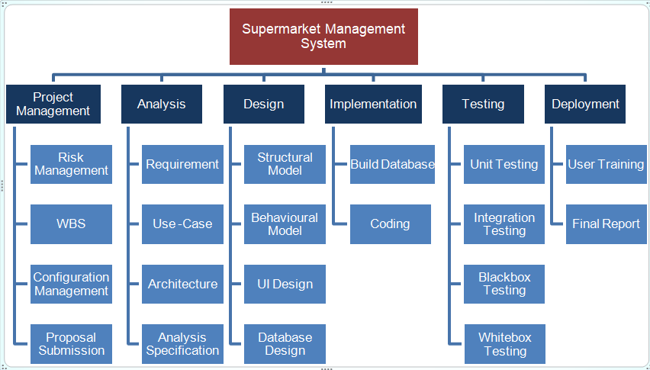
Work Breakdown Structure

Slide 10
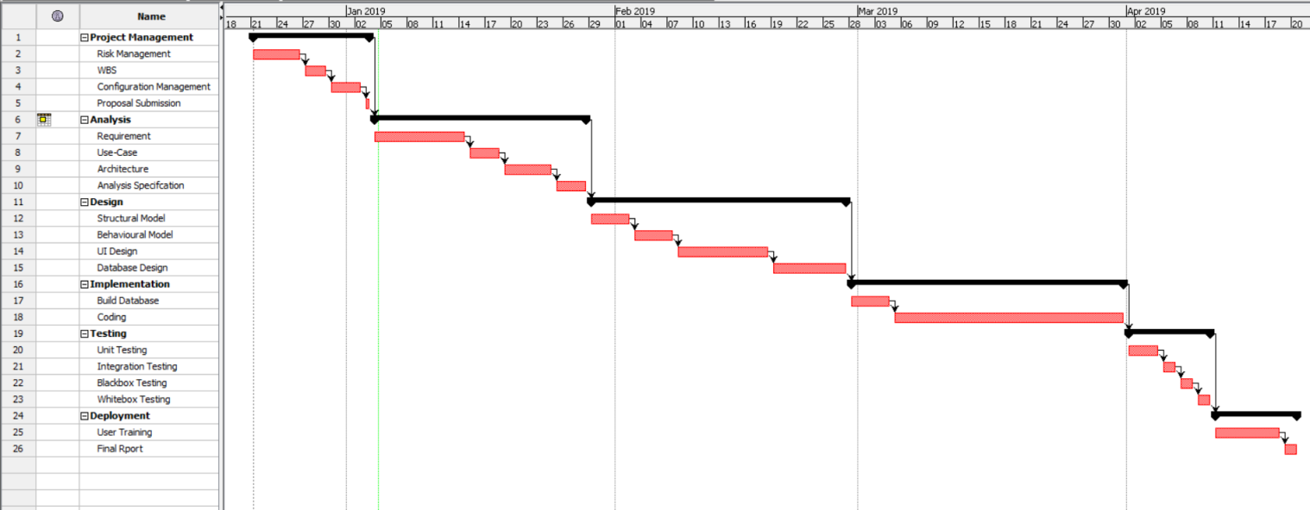
Gantt Chart

Slide 11
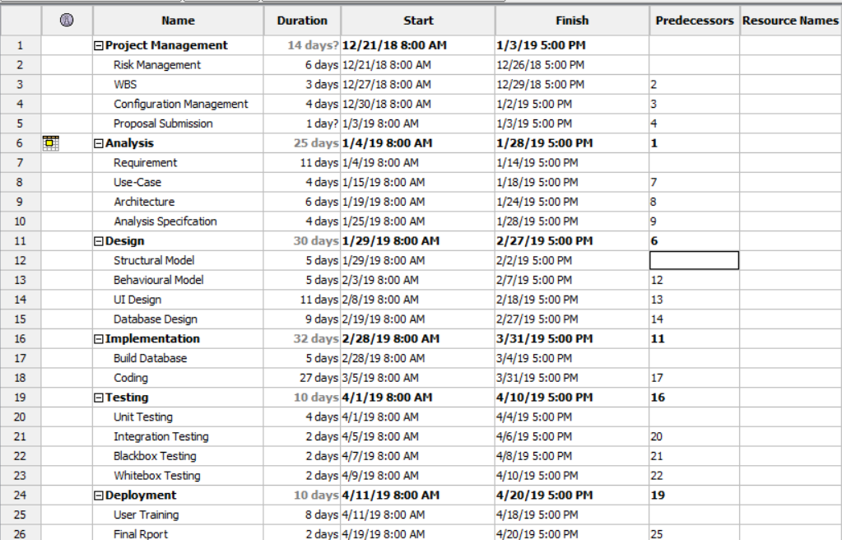
Scheduling

Slide 12
MoSCoW prioritization
MoSCoW prioritization is a technique for helping to understand and manage priorities.
The letter stand for:
Must Have
Should Have
Could Have
Won’t Have

Slide 13
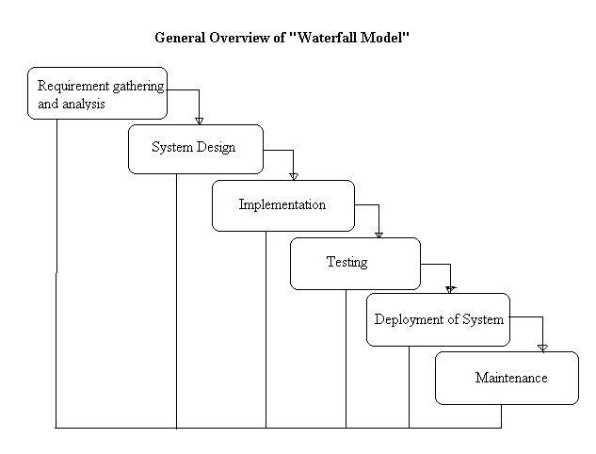
Waterfall Methodology

Slide 14
Waterfall Methodology
I have used this methodology for the following reasons:
It is simple and easy to understand.
It enables to find error early in the requirement analysis stage.
It is easier to keep on budget.
Due to the rigidity of the model each stage has certain deliverables and a review process which make easier to manage.
In this model, stages do not overlap. There stages are processed and completed one at a time.
Notes:
I have used waterfall methodology in my supermarket management system project which helps to manage my project on a sequential design process; it finishes on stage before another stage can begin.

Slide 15
Architecture
I have used MVC architectural pattern which contains three folders i.e. model, view and controller that is used to separate application’s regard.
M(Model) – It shows the functionality of the application.
V(View) - Deals with the interface. User can view the interface of the system.
C(Controller) – It handles the user interaction.

Slide 16
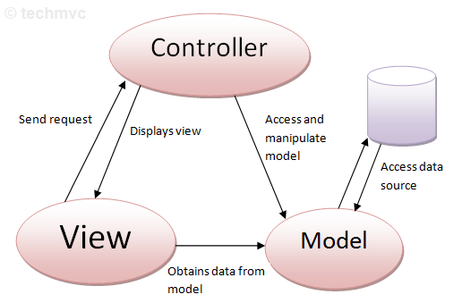
MVC Architecture

Slide 17
Risk Management
Risk management should always be pro-active.
To avoid or minimize the adverse effects of unforeseen events.
Should applied to all projects.

Slide 18
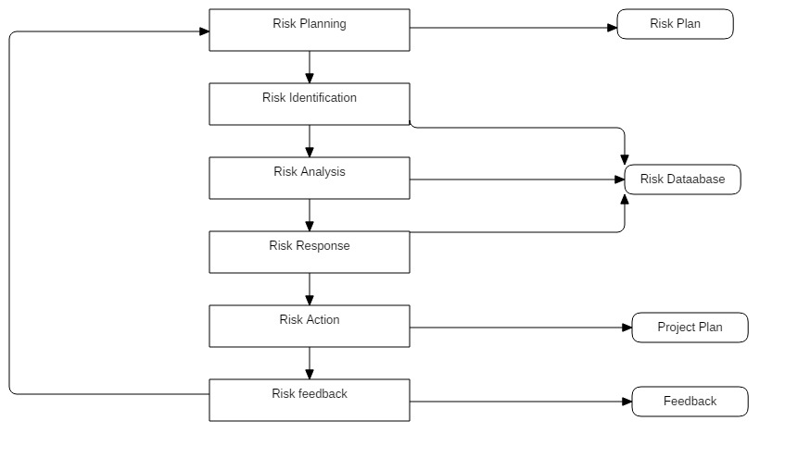
Risk Management Process

Slide 19
Configuration Management
Configuration management is the preserver of the quality of the emerging solution, controlling the elements of the solution as it is developed.
It is a version controller.
Why configuration management?
It manage the code.
It is used for rollback.
It is used for change implementation.

Slide 20
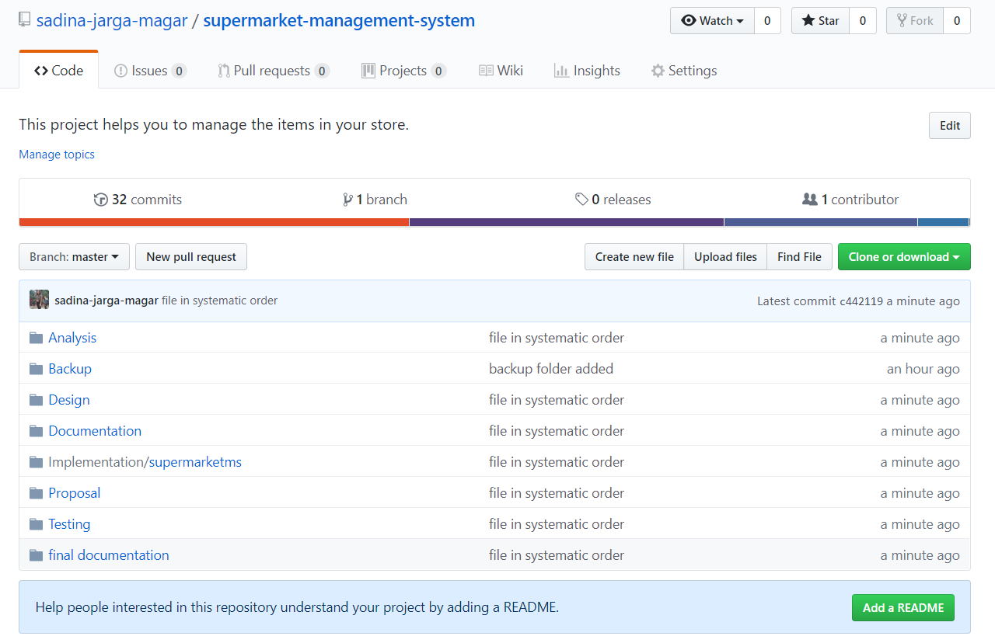

Slide 21
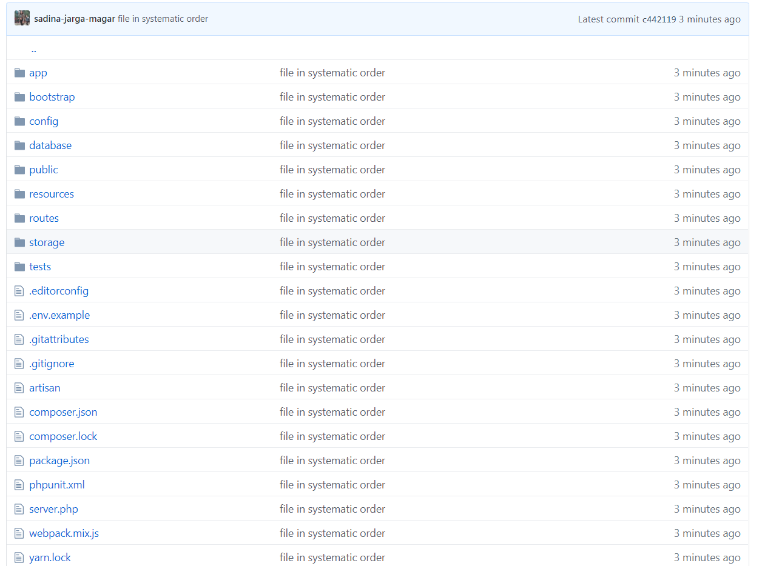

Slide 22
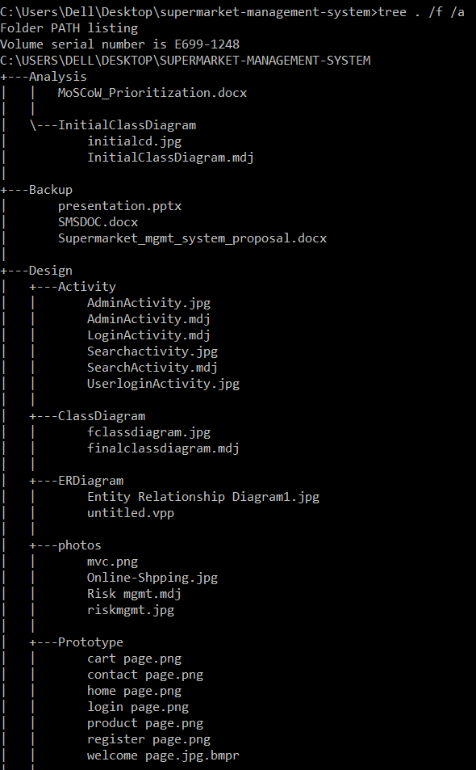
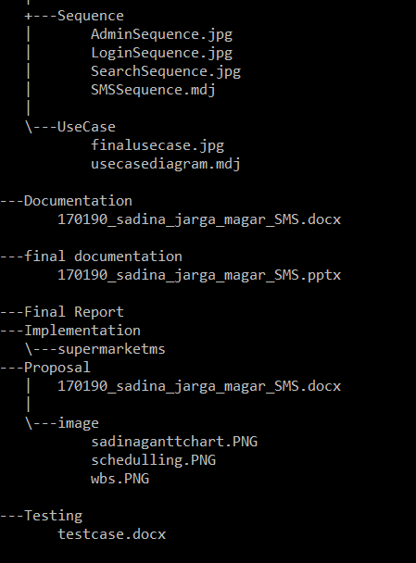

Slide 23
Diagrams
Behavioral Diagram
Structural Diagram

Slide 24
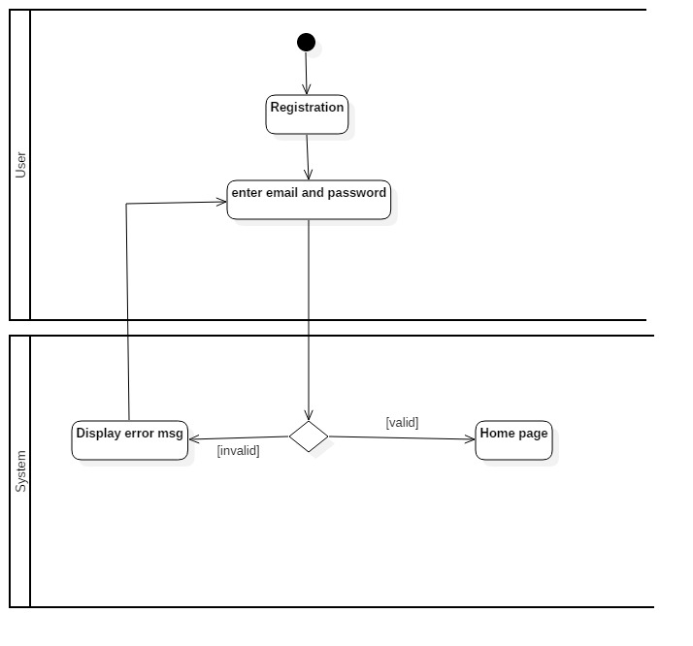
A) Behavioral Diagram
Activity Diagram of login

Slide 25
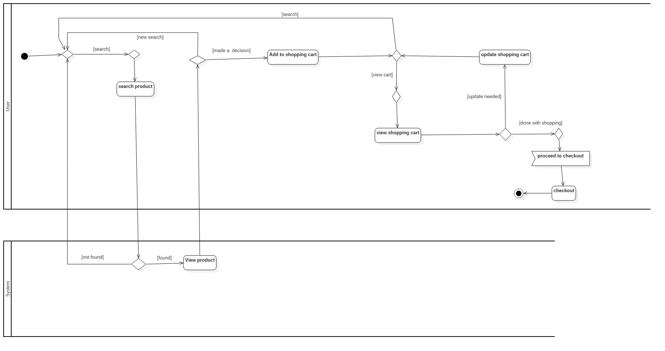
2) Activity Diagram of online shopping

Slide 26
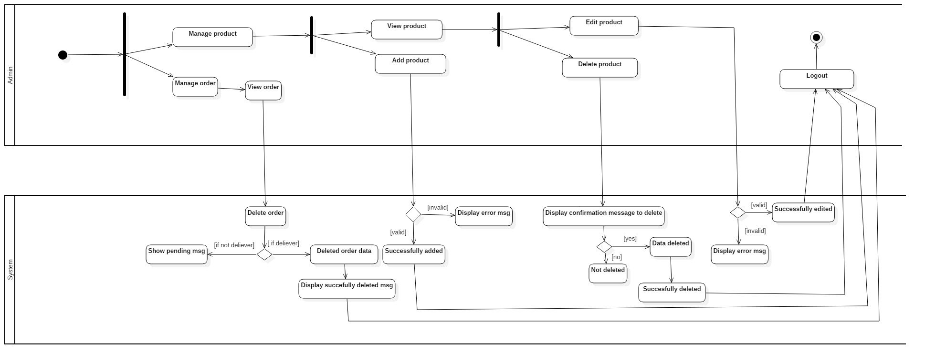
3) Activity Diagram of admin

Slide 27
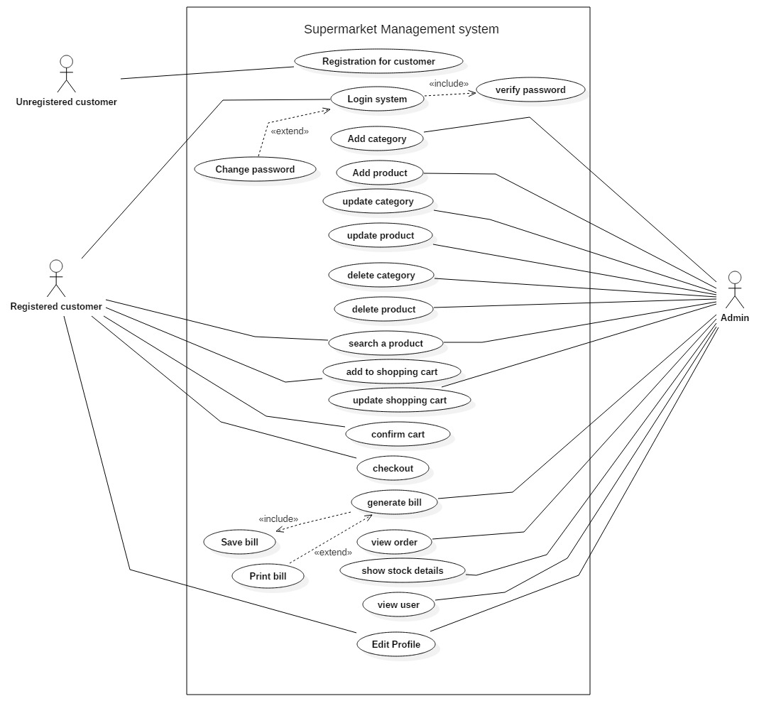
2) Use Case Diagram

Slide 28
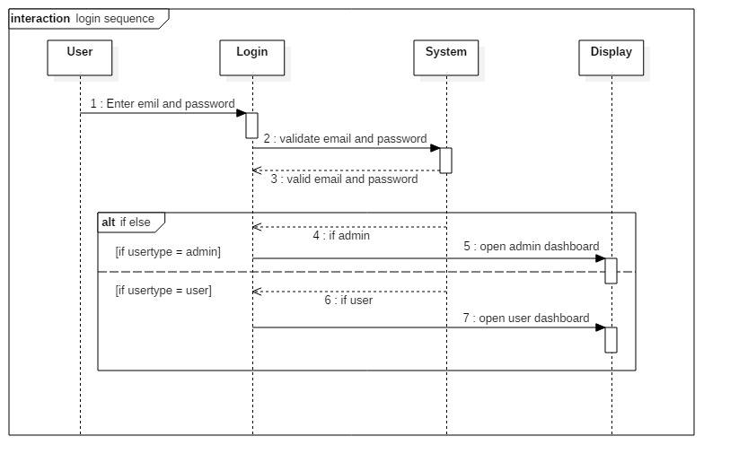
3) Sequence Diagram
1) Login

Slide 29
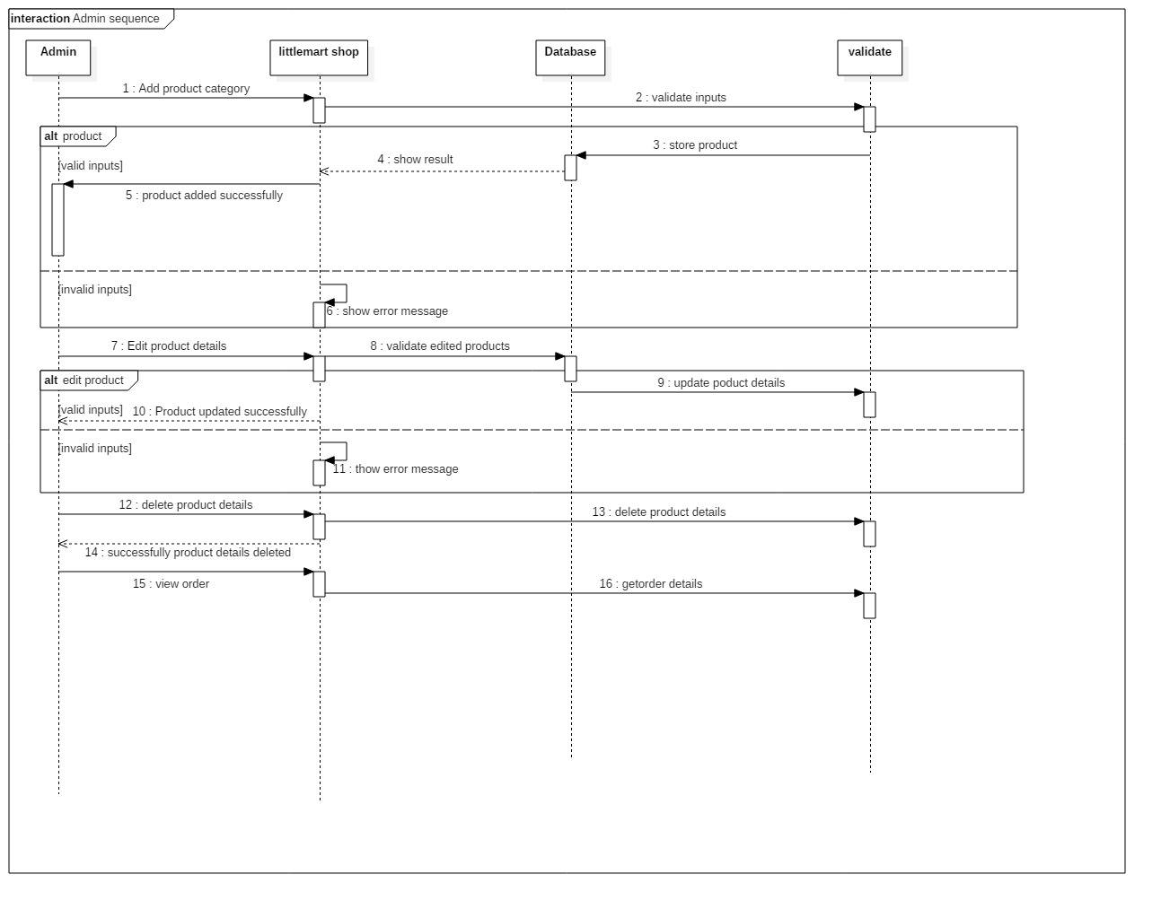
3) Sequence Diagram
2) Admin

Slide 30
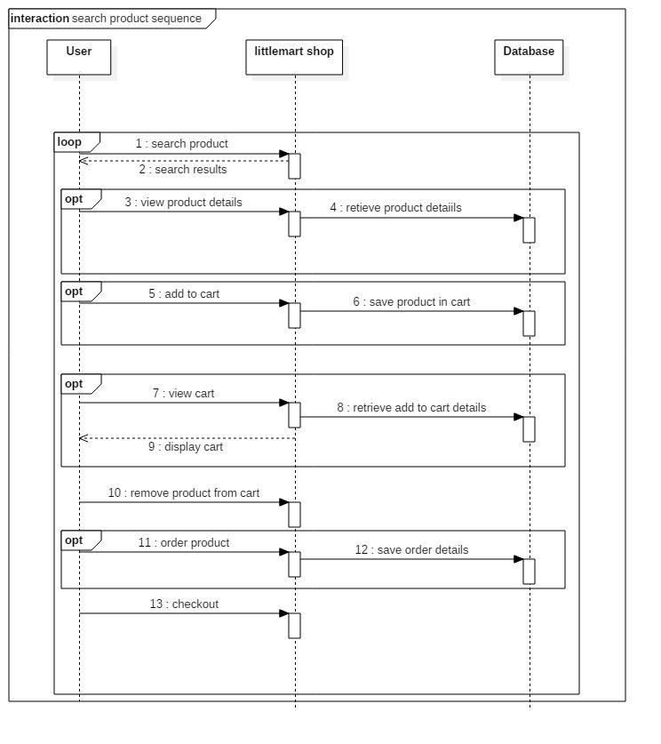
3) Sequence Diagram
3) Search

Slide 31
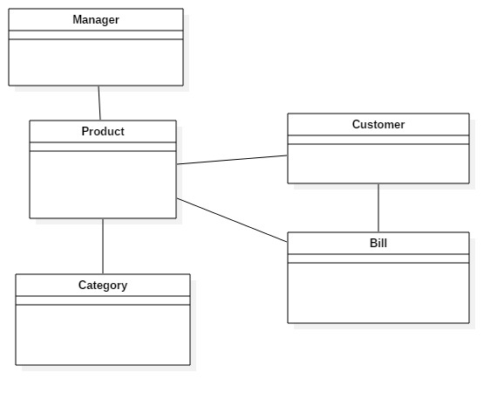
B) Structural Diagram
4) Initial Class Diagram

Slide 32
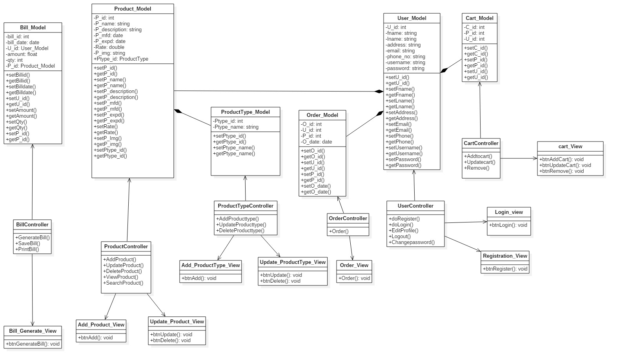
5) Final Class Diagram

Slide 33
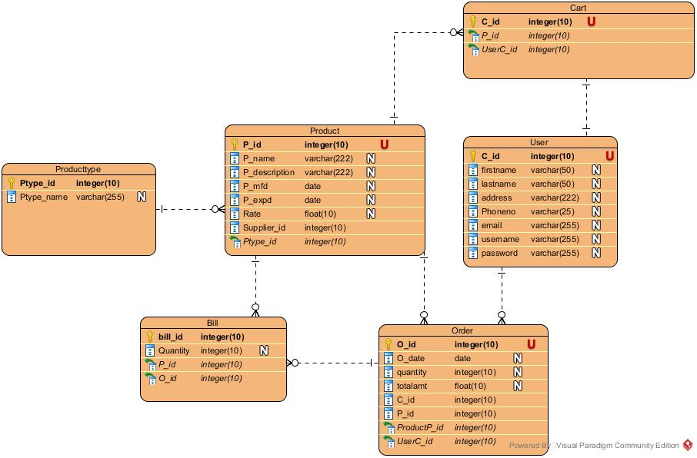
6) Entity Relationship-Diagram

Slide 34
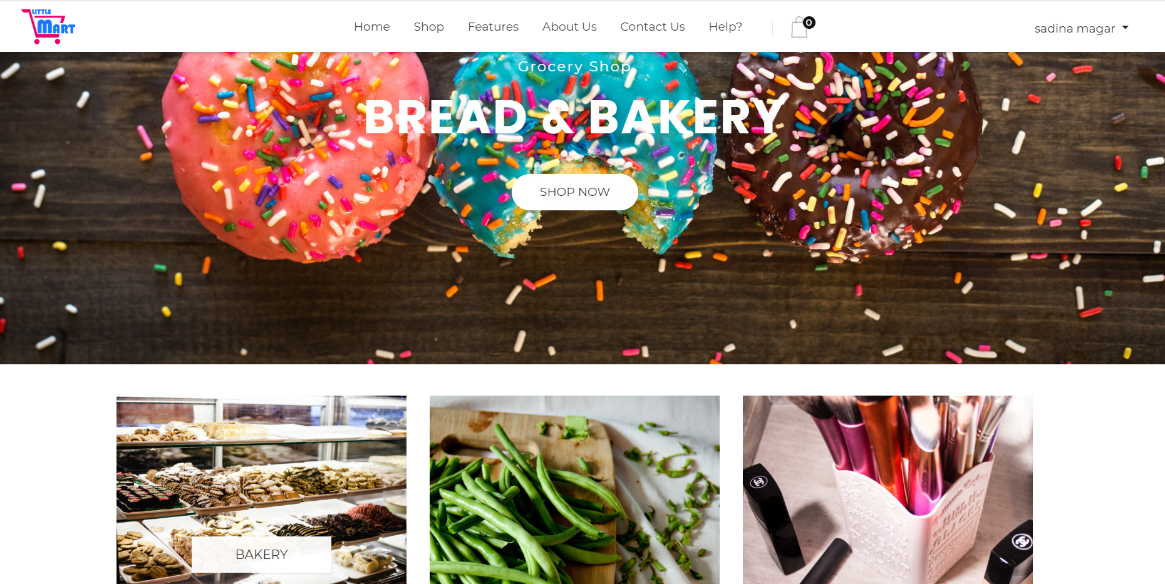
UI design and coding
UI design of home page

Slide 35
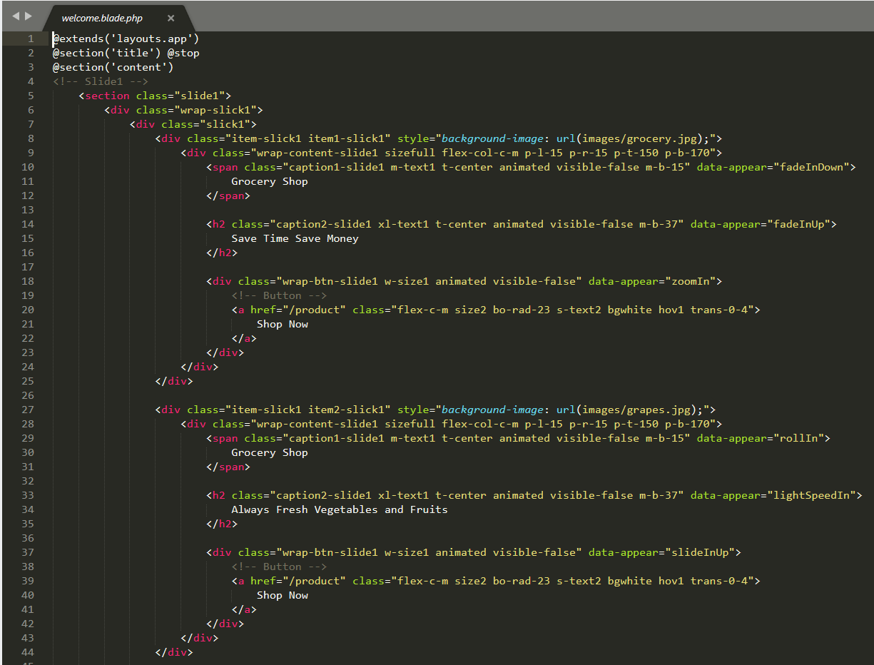
Coding of home page

Slide 36
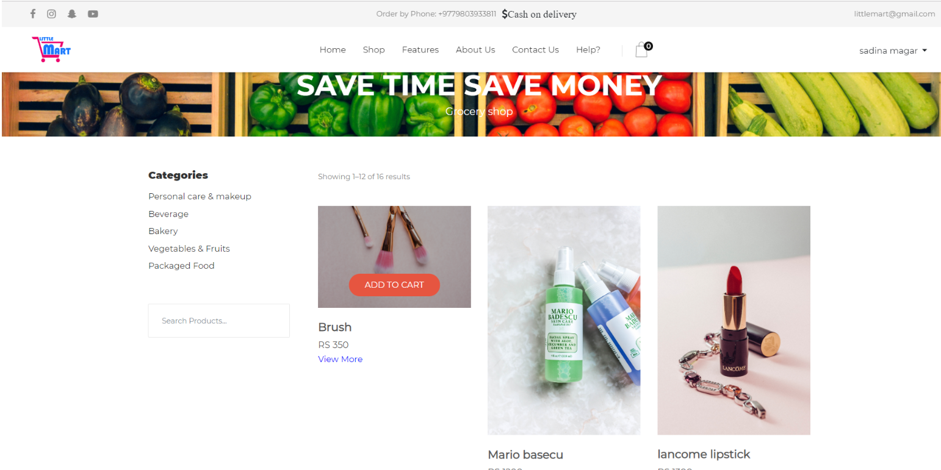
2) UI design of product page

Slide 37
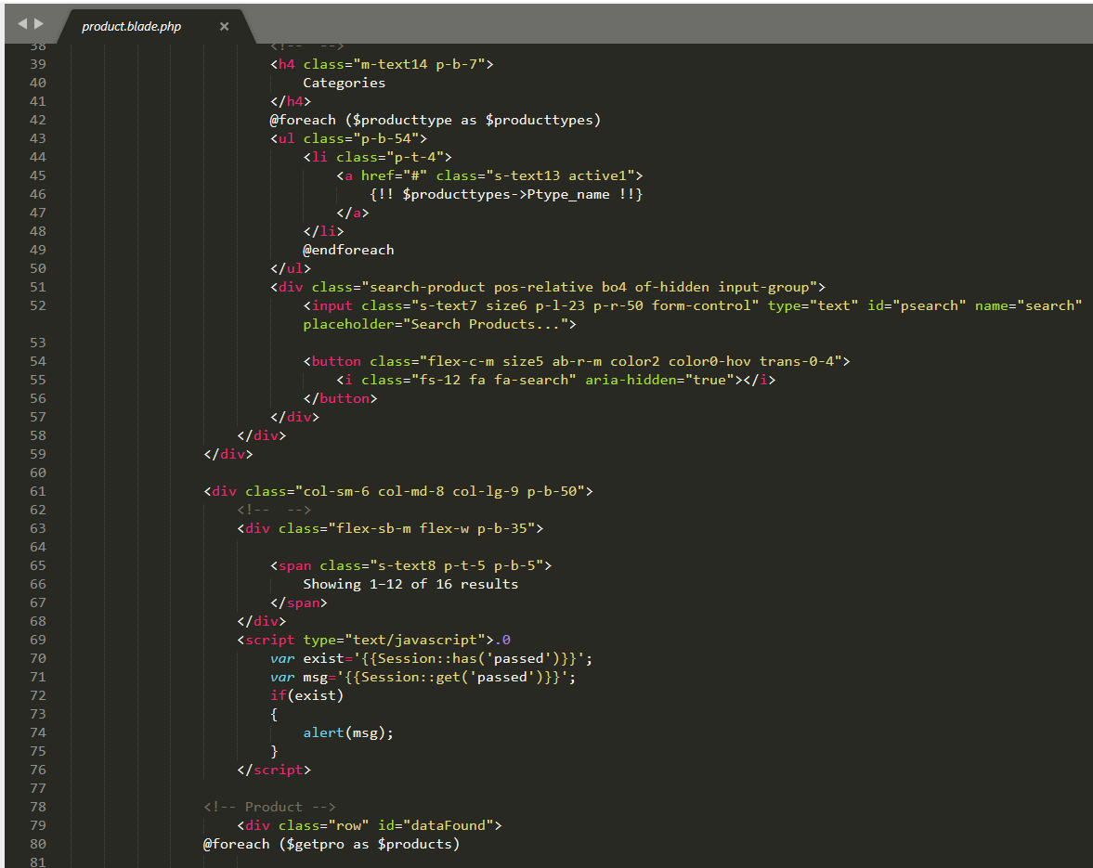
Coding of product page

Slide 38
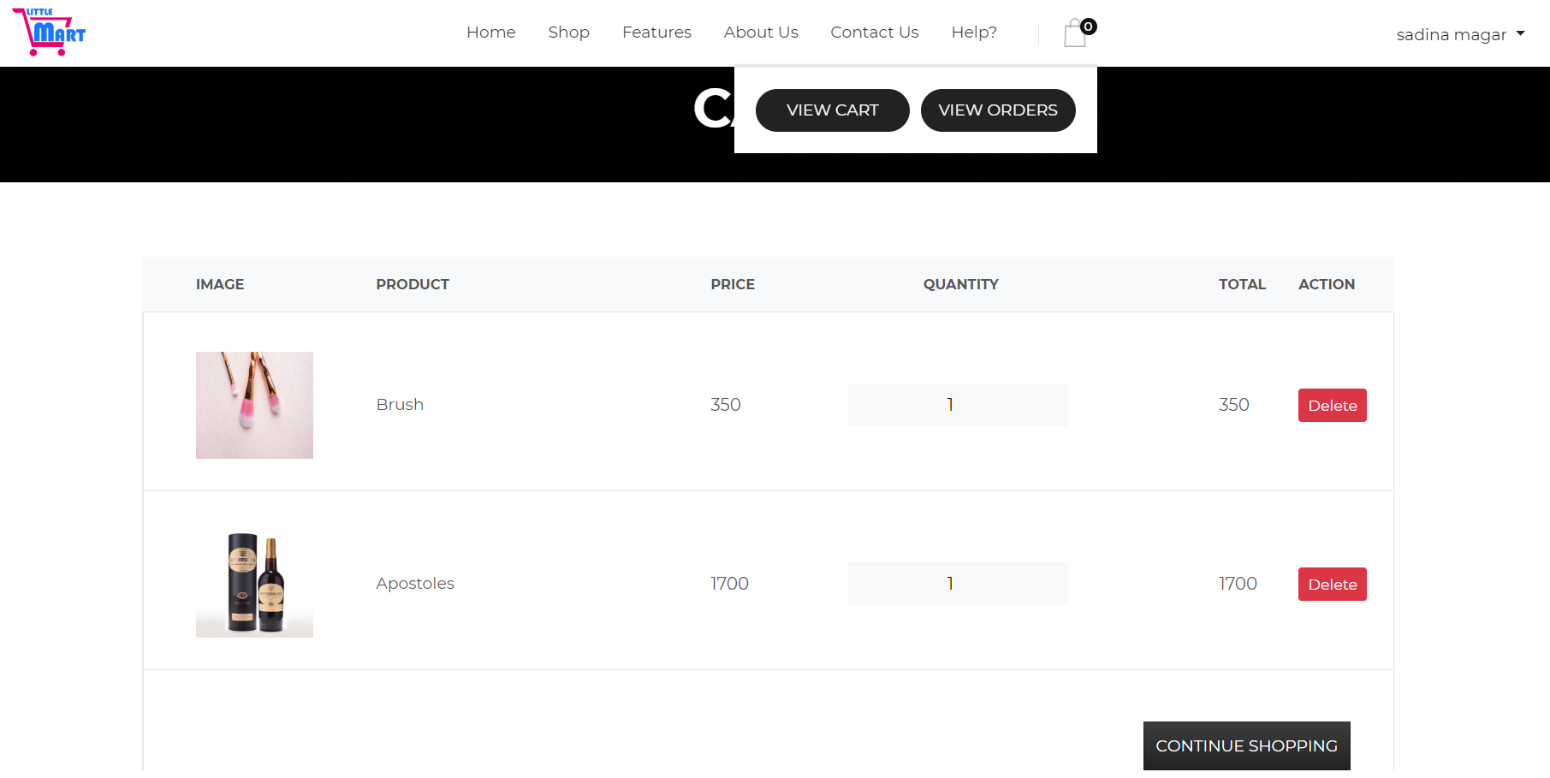
3) UI design of cart page

Slide 39
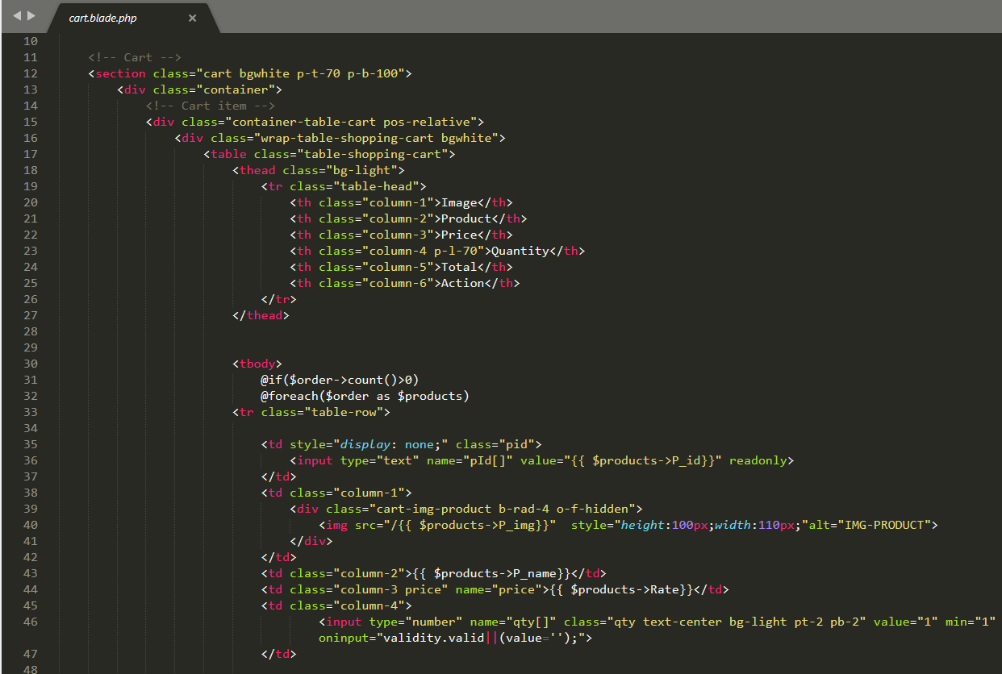
Coding of cart page

Slide 40
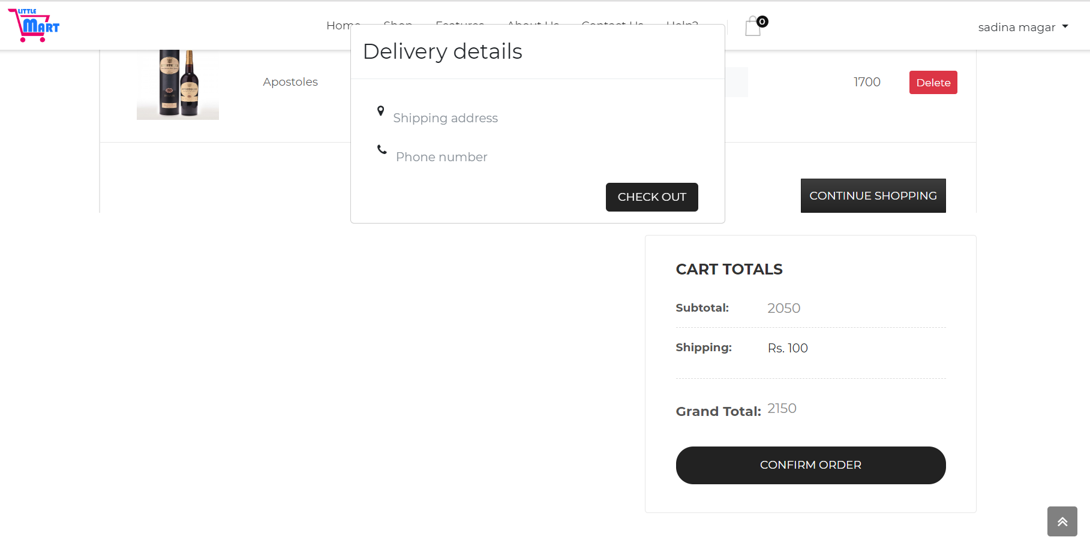
4) UI design of Checkout and calculation

Slide 41
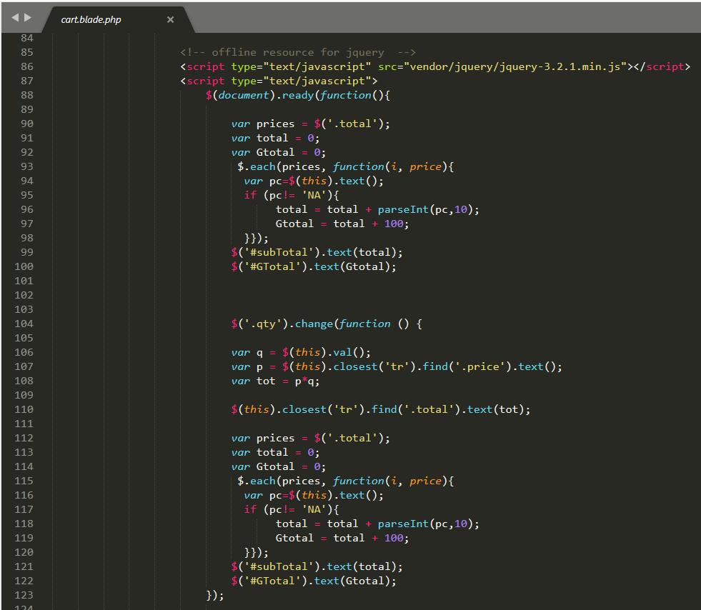
Coding of Checkout and calculation

Slide 42
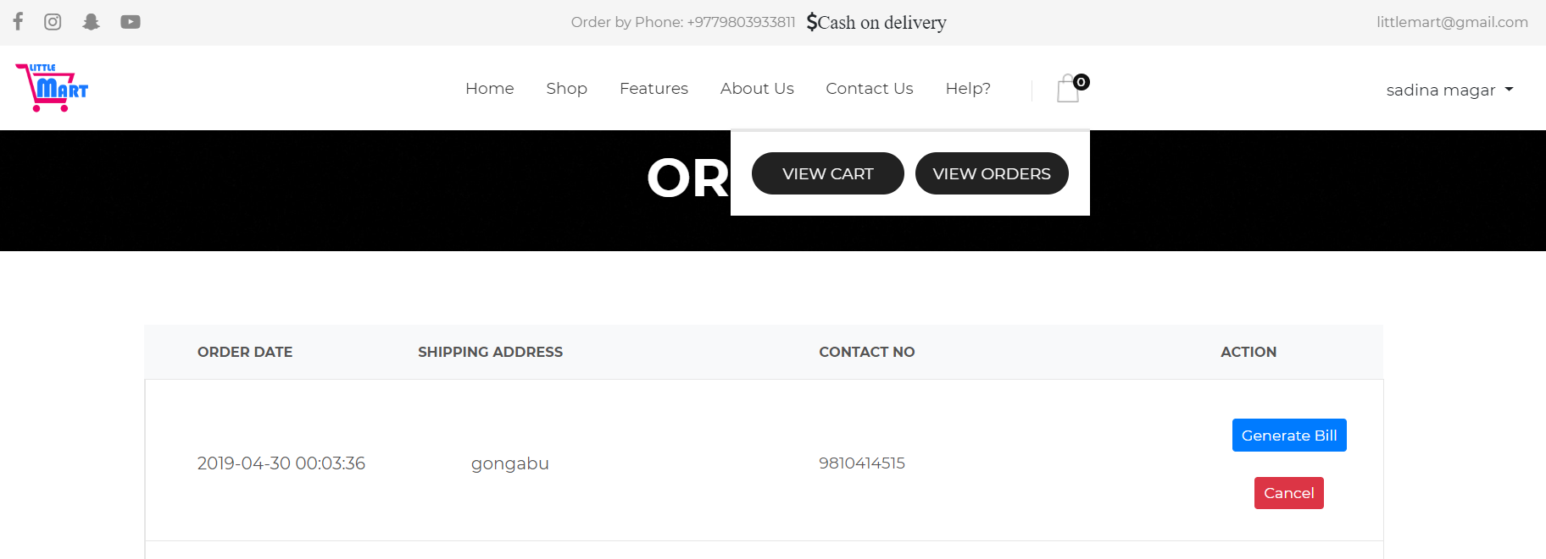
5) UI design of bill generating

Slide 43
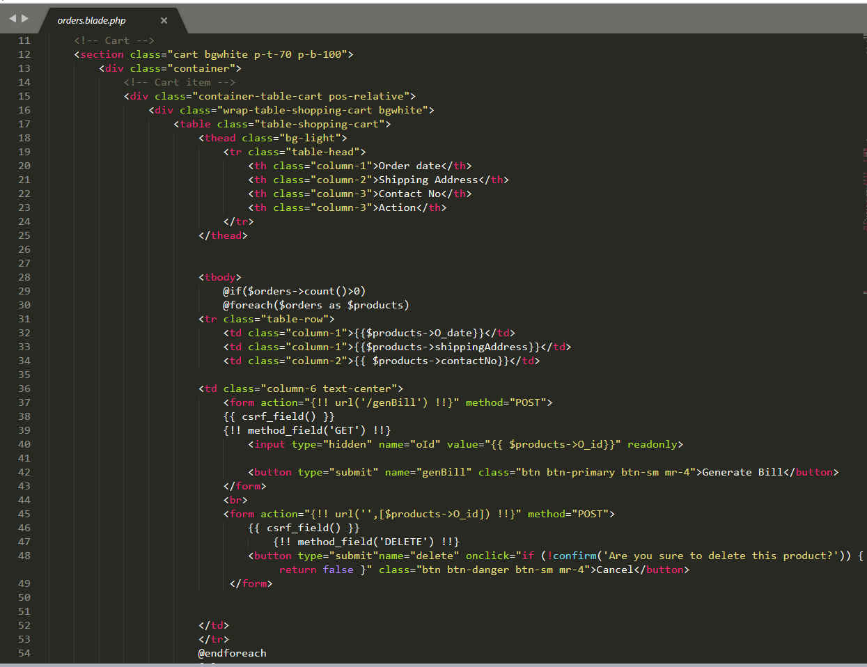
Coding of bill generating

Slide 44
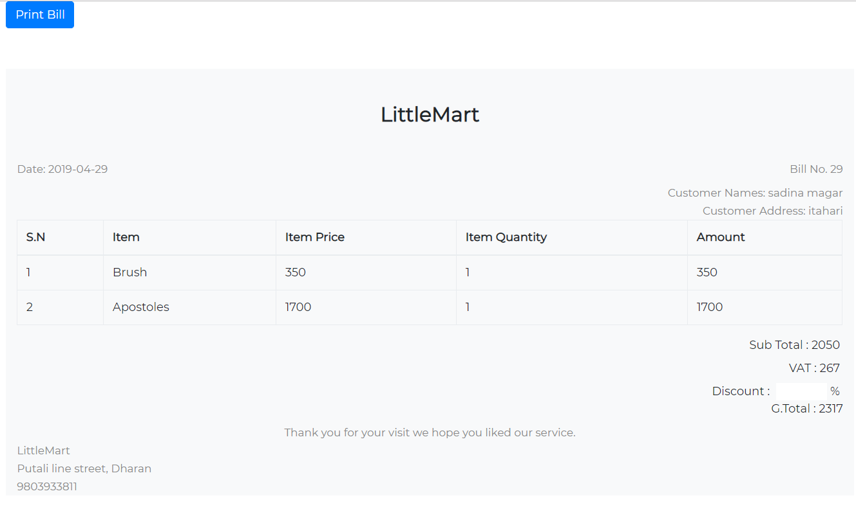
6) UI design of bill

Slide 45
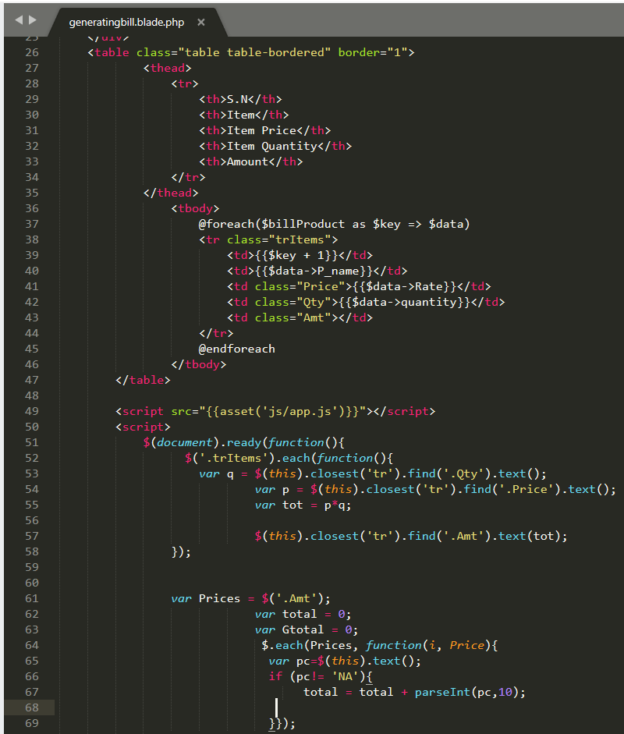
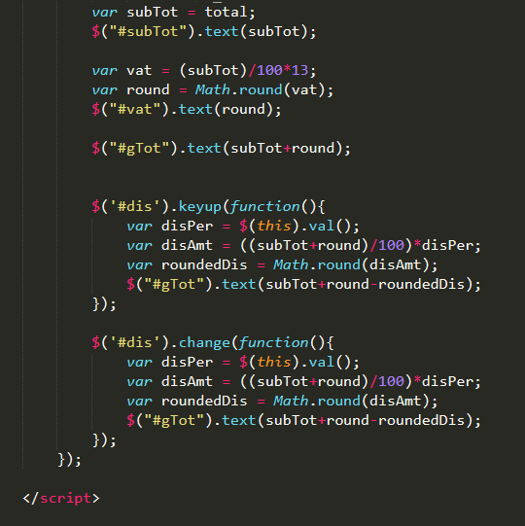
Coding of bill

Slide 46
Test case and testing
Unit testing
Blackbox testing

Slide 47
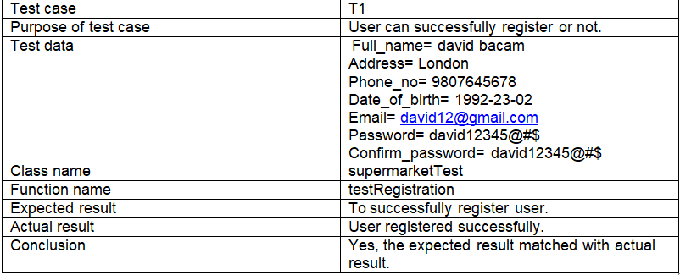
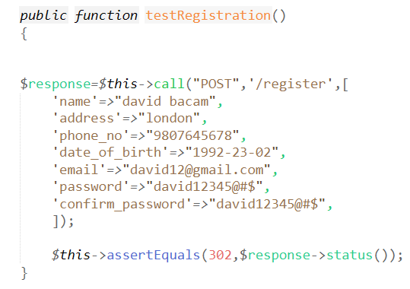
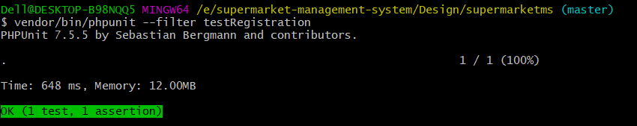
1. Registration (Unit testing)

Slide 48
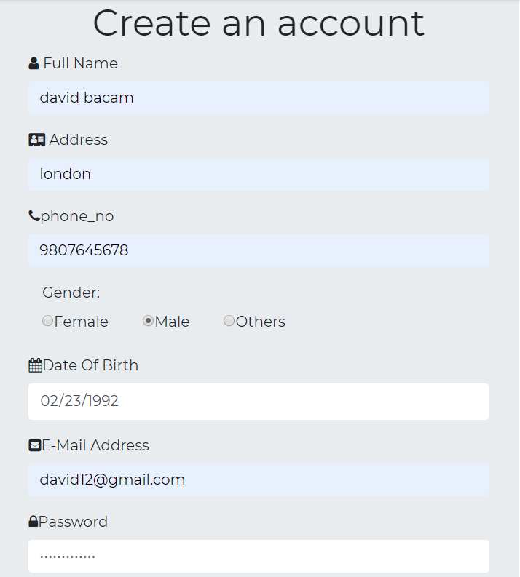
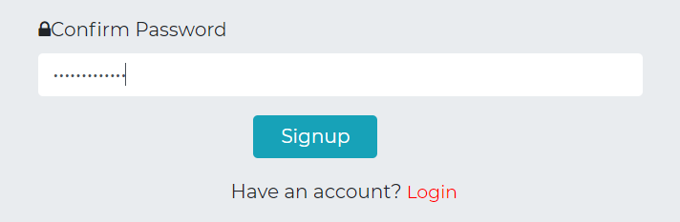
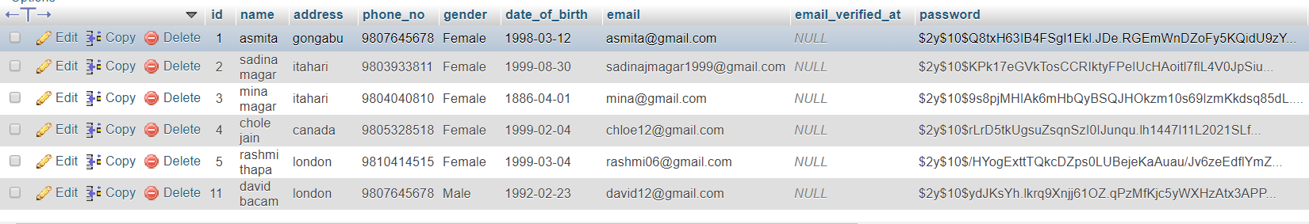
Blackbox testing:
User is successfully registered

Slide 49
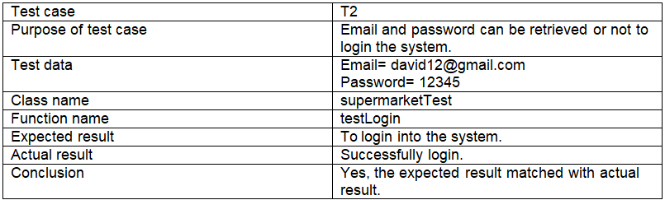
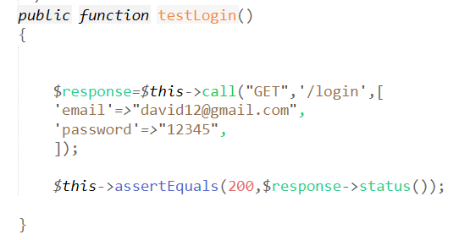
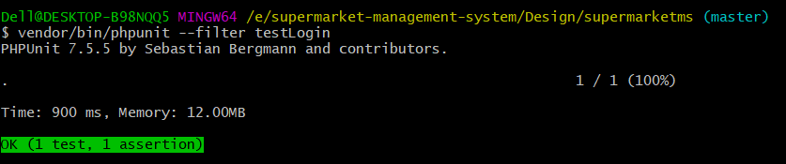
2. Login (Unit testing)

Slide 50
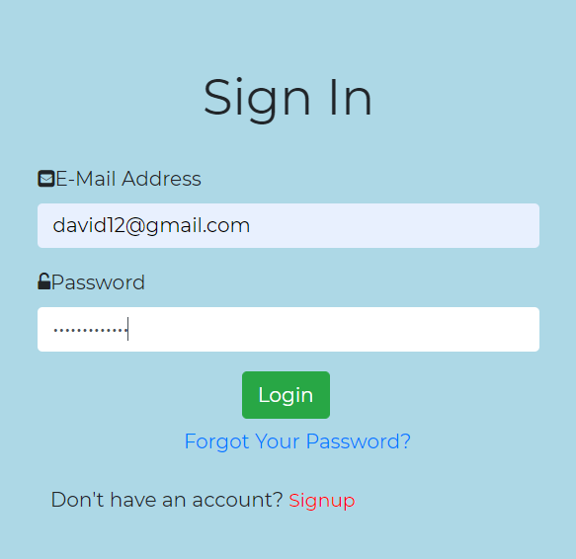
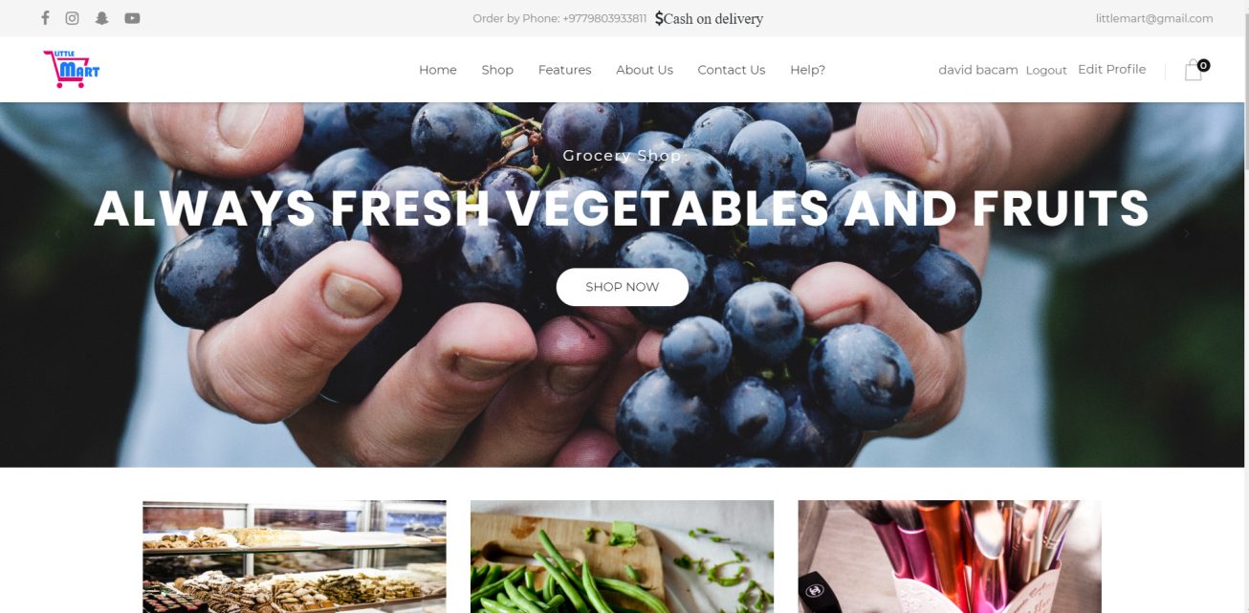
Blackbox testing:
David bacam is logged in.

Slide 51
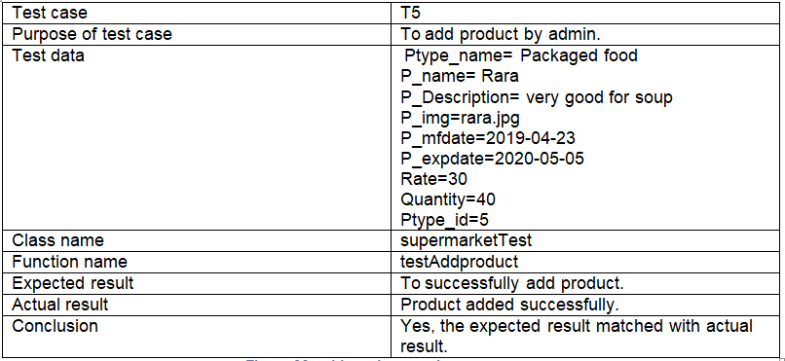
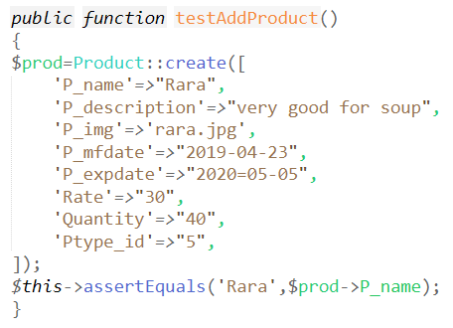
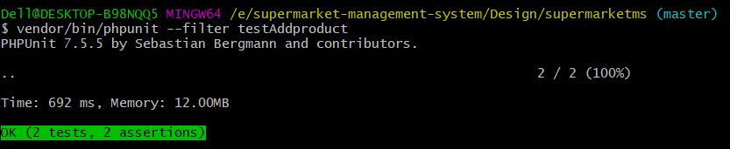
3. Add product (Unit testing)

Slide 52
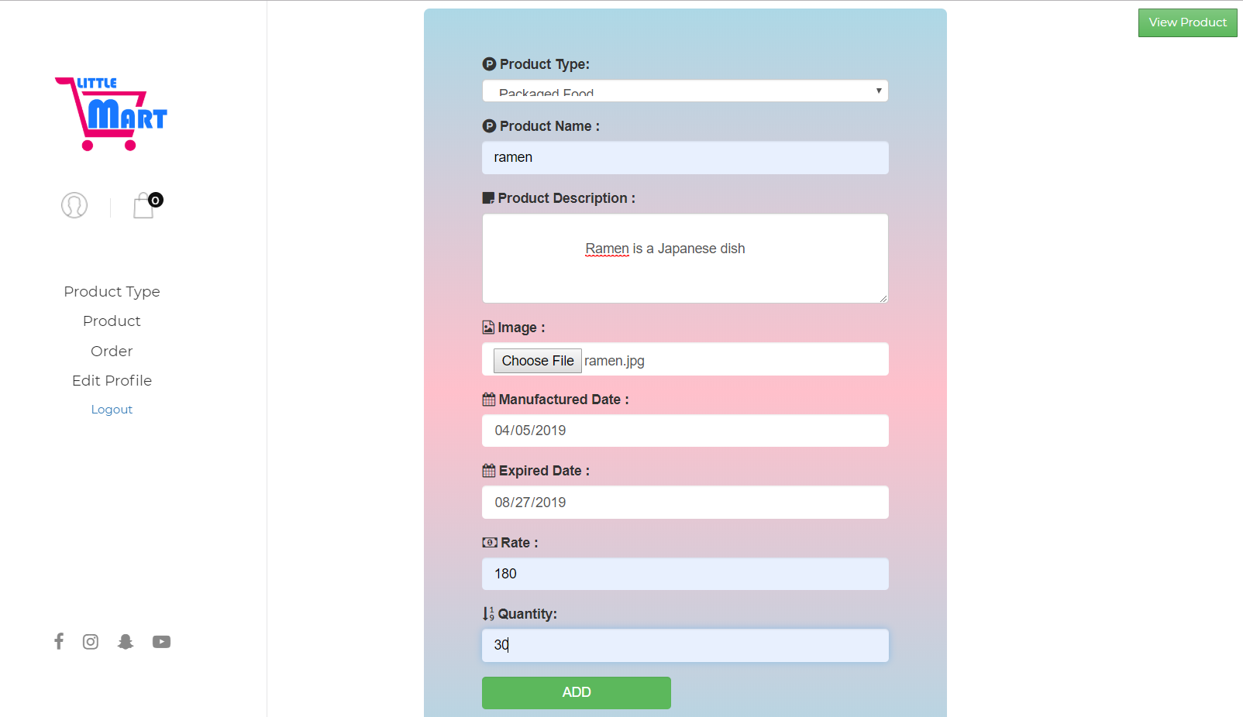
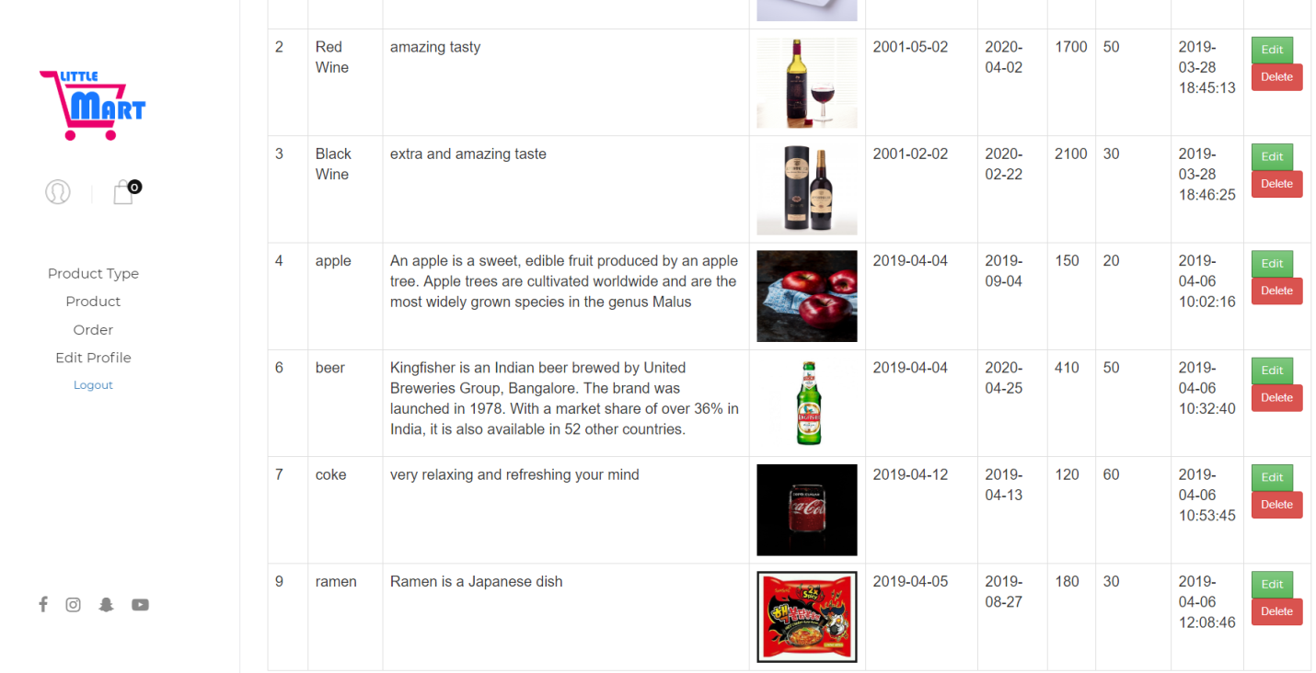
Blackbox testing:

Slide 53
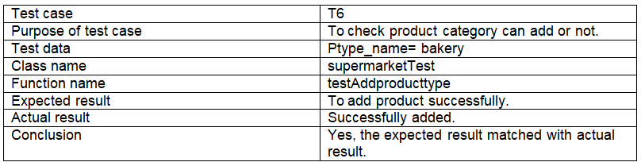


4. Add product type (Unit testing)

Slide 54


Blackbox testing:
Product type is added successfully.

Slide 55



5. Update product type (Unit testing)

Slide 56


Blackbox testing:
Bakery is updated successfully.

Slide 57



6. Delete product type (Unit testing)

Slide 58


Blackbox testing:
Bakery is deleted successfully.

Slide 59



7. Database (Unit testing)

Slide 60



8. Contact (Unit testing)

Slide 61


Black box testing:

Slide 62

9. Registration validation form(Black-box testing)

Slide 63




Slide 64


Slide 65



10. Visit page(Unit testing)

Slide 66
Future Work
Use of payment system
Online chat system
Product and orders notification

Slide 67
Limitation
Online transaction is not available.
User cannot chat online.
User cannot see their notification after their product is added in their cart until and unless they see their carts.

Slide 68
Conclusion
Finally, the web-site is developed by using the different tools, techniques, methodology and approaches for this project which gives you the self-automation and self-service while purchasing the products.

Slide 69
References
https://www.slideshare.net/pujithaboggarapu/grocery-management-system [Accessed on: 1st April 2019]
http://shodhganga.inflibnet.ac.in/bitstream/10603/11075/10/10_conclusion.pdf [Accessed on: 1st April 2019]
https://www.agilebusiness.org/content/moscow-prioritisation [Accessed on: 23rd march 2019]
https://www.smartdraw.com/use-case-diagram/
[Accessed on:30th April 2019]

